Slide 1

DMH1F4 – SISTEM BASIS DATA
Semester Ganjil 2016/2017
SQL 1
Disajikan oleh : Tim Pengajar Sistem Basis Data
Hanya dipergunakan untuk kepentingan pengajaran di lingkungan Telkom University

Slide 2
Outline
Basic Structure
Basic Operation
Aggregation
Null Value
SubQuery
View

Slide 3
SQL Statements
A SELECT statement retrieves information from the database. Using a SELECT statement, you can do the following:
Projection: You can use the projection capability in SQL to choose the columns in a table that you want returned by your query. You can choose as few or as many columns of the table as you require.
Selection: You can use the selection capability in SQL to choose the rows in a table that you want returned by a query. You can use various criteria to restrict the rows that you see.
Joining: You can use the join capability in SQL to bring together data that is stored in different tables by creating a link between them. You learn more about joins in a later lesson.

Slide 4
Aljabar Relational Review
Projection
Selection
Table 1
Table 1
Join
Table 1
Table 2

Slide 5
Basic SELECT Statement
SELECT *|{[DISTINCT] column|expression [alias],...}
FROM table;
SELECT identifies what columns
FROM identifies which table
Notes:
Basic SELECT Statement
In its simplest form, a SELECT statement must include the following:
A SELECT clause, which specifies the columns to be displayed
A FROM clause, which specifies the table containing the columns listed in the SELECT clause
In the syntax:
SELECT is a list of one or more columns
* selects all columns
DISTINCT suppresses duplicates
column|expression selects the named column or the expression
alias gives selected columns different headings
FROM table specifies the table containing the columns
Note: Throughout this course, the words keyword, clause, and statement are used as follows:
A keyword refers to an individual SQL element. For example, SELECT and FROM are keywords.
A clause is a part of a SQL statement. For example, SELECT employee_id, last_name, ... is a clause.
A statement is a combination of two or more clauses. For example, SELECT * FROM employees is a SQL statement.

Slide 6
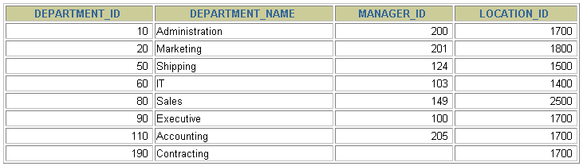
Selecting All Columns
SELECT *
FROM departments;
Notes:
Selecting All Columns of All Rows
You can display all columns of data in a table by following the SELECT keyword with an asterisk (*). In the example on the slide, the department table contains four columns: DEPARTMENT_ID, DEPARTMENT_NAME, MANAGER_ID, and LOCATION_ID. The table contains seven rows, one for each department.
You can also display all columns in the table by listing all the columns after the SELECT keyword. For example, the following SQL statement, like the example on the slide, displays all columns and all rows of the DEPARTMENTS table:
SELECT department_id, department_name, manager_id, location_id
FROM departments;
Instructor Note
Let the students know that details of all the tables are given in Appendix B.

Slide 7
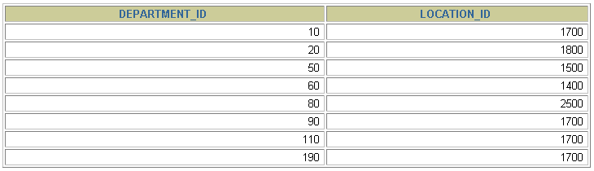
Selecting Specific Columns
SELECT department_id, location_id
FROM departments;
Notes:
Selecting Specific Columns of All Rows
You can use the SELECT statement to display specific columns of the table by specifying the column names, separated by commas. The example on the slide displays all the department numbers and location numbers from the DEPARTMENTS table.
In the SELECT clause, specify the columns that you want, in the order in which you want them to appear in the output. For example, to display location before department number going from left to right, you use the following statement:
SELECT location_id, department_id
FROM departments;
Instructor Note
You can also select from pseudocolumns. A pseudocolumn behaves like a table column but is not actually stored in the table. You cannot insert or delete values of the pseudocolumns. Some available pseudocolumns are CURRVAL, NEXTVAL, LEVEL, ROWID, and ROWNUM.
…

Slide 8
Arithmetic Expressions
Create expressions with number and date data by using arithmetic operators.
Operator
+
-
*
/
Description
Add
Subtract
Multiply
Divide
Notes:
Arithmetic Expressions
You may need to modify the way in which data is displayed, perform calculations, or look at what-if scenarios. These are all possible using arithmetic expressions. An arithmetic expression can contain column names, constant numeric values, and the arithmetic operators.
Arithmetic Operators
The slide lists the arithmetic operators available in SQL. You can use arithmetic operators in any clause of a SQL statement except in the FROM clause.
Instructor Note
You can use the addition and subtraction operators only with DATE and TIMESTAMP data types.

Slide 9
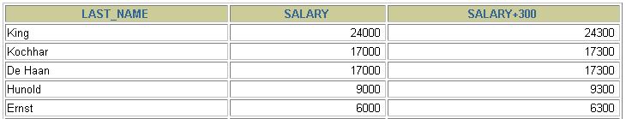

Using Arithmetic Operators
SELECT last_name, salary, salary + 300
FROM employees;
…
Notes:
Using Arithmetic Operators
The example in the slide uses the addition operator to calculate a salary increase of $300 for all employees and displays a new SALARY+300 column in the output.
Note that the resultant calculated column SALARY+300 is not a new column in the EMPLOYEES table; it is for display only. By default, the name of a new column comes from the calculation that generated it—in this case, salary+300.
Note: The Oracle9i server ignores blank spaces before and after the arithmetic operator.

Slide 10
Operator Precedence
_
*
/
+
Multiplication and division take priority over addition and subtraction.
Operators of the same priority are evaluated from left to right.
Parentheses are used to force prioritized evaluation and to clarify statements.
Notes:
Operator Precedence
If an arithmetic expression contains more than one operator, multiplication and division are evaluated first. If operators within an expression are of same priority, then evaluation is done from left to right.
You can use parentheses to force the expression within parentheses to be evaluated first.

Slide 11
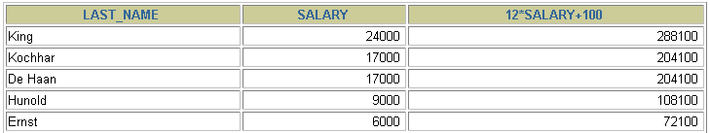

Operator Precedence
SELECT last_name, salary, 12*salary+100
FROM employees;
…
Notes:
Operator Precedence (continued)
The example on the slide displays the last name, salary, and annual compensation of employees. It calculates the annual compensation as 12 multiplied by the monthly salary, plus a one-time bonus of $100. Notice that multiplication is performed before addition.
Note: Use parentheses to reinforce the standard order of precedence and to improve clarity. For example, the expression on the slide can be written as (12*salary)+100 with no change in the result.
Instructor Note
Demo: 1_prec1.sql, 1_prec2.sql
Purpose: To illustrate viewing a query containing no parentheses and executing a query with parentheses to override rules of precedence.

Slide 12
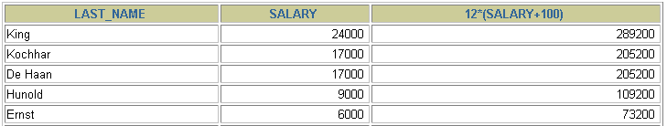

Using Parentheses
SELECT last_name, salary, 12*(salary+100)
FROM employees;
…
Notes:
Using Parentheses
You can override the rules of precedence by using parentheses to specify the order in which operators are executed.
The example on the slide displays the last name, salary, and annual compensation of employees. It calculates the annual compensation as monthly salary plus a monthly bonus of $100, multiplied by 12. Because of the parentheses, addition takes priority over multiplication.

Slide 13
Defining a Column Alias
A column alias:
Renames a column heading
Is useful with calculations
Immediately follows the column name - there can also be the optional AS keyword between the column name and alias
Requires double quotation marks if it contains spaces or special characters or is case sensitive
Notes:
Column Aliases
When displaying the result of a query, iSQL*Plus normally uses the name of the selected column as the column heading. This heading may not be descriptive and hence may be difficult to understand. You can change a column heading by using a column alias.
Specify the alias after the column in the SELECT list using a space as a separator. By default, alias headings appear in uppercase. If the alias contains spaces or special characters (such as # or $), or is case sensitive, enclose the alias in double quotation marks (" ").
Instructor Note
Within a SQL statement, a column alias can be used in both the SELECT clause and the ORDER BY clause. You cannot use column aliases in the WHERE clause. Both alias features comply with the ANSI SQL 92 standard.
Demo: 1_alias.sql
Purpose: To illustrate the use of aliases in expressions.

Slide 14


Using Column Aliases
SELECT last_name AS name, commission_pct comm
FROM employees;
…
SELECT last_name "Name", salary*12 "Annual Salary"
FROM employees;
…
Notes:
Column Aliases (continued)
The first example displays the names and the commission percentages of all the employees. Notice that the optional AS keyword has been used before the column alias name. The result of the query is the same whether the AS keyword is used or not. Also notice that the SQL statement has the column aliases, name and comm, in lowercase, whereas the result of the query displays the column headings in uppercase. As mentioned in a previous slide, column headings appear in uppercase by default.
The second example displays the last names and annual salaries of all the employees. Because Annual Salary contain a space, it has been enclosed in double quotation marks. Notice that the column heading in the output is exactly the same as the column alias.
Instructor Note
Point out the optional AS keyword in the first example and the double quotation marks in the second example. Also show that the aliases always appear in uppercase, unless enclosed within double quotation marks.

Slide 15
Concatenation Operator
A concatenation operator:
Concatenates columns or character strings to other columns
Is represented by two vertical bars (||)
Creates a resultant column that is a character expression
Notes:
Concatenation Operator
You can link columns to other columns, arithmetic expressions, or constant values to create a character expression by using the concatenation operator (||). Columns on either side of the operator are combined to make a single output column.

Slide 16
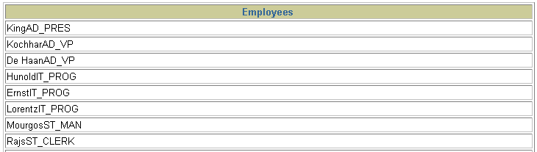
Using the Concatenation Operator
SELECT last_name||job_id AS "Employees"
FROM employees;
…
Notes:
Concatenation Operator (continued)
In the example, LAST_NAME and JOB_ID are concatenated, and they are given the alias Employees. Notice that the employee last name and job code are combined to make a single output column.
The AS keyword before the alias name makes the SELECT clause easier to read.

Slide 17
Literal Character Strings
A literal is a character, a number, or a date included in the SELECT list.
Date and character literal values must be enclosed within single quotation marks.
Each character string is output once for each row returned.
Notes:
Literal Character Strings
A literal is a character, a number, or a date that is included in the SELECT list and that is not a column name or a column alias. It is printed for each row returned. Literal strings of free-format text can be included in the query result and are treated the same as a column in the SELECT list.
Date and character literals must be enclosed within single quotation marks (' '); number literals need not.

Slide 18
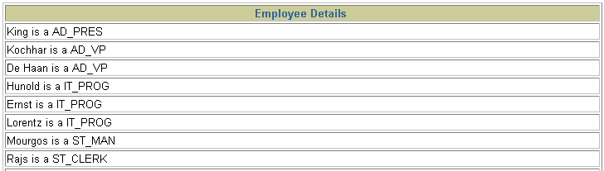
Using Literal Character Strings
SELECT last_name ||' is a '||job_id
AS "Employee Details"
FROM employees;
…
Notes:
Literal Character Strings (continued)
The example on the slide displays last names and job codes of all employees. The column has the heading Employee Details. Notice the spaces between the single quotation marks in the SELECT statement. The spaces improve the readability of the output.
In the following example, the last name and salary for each employee are concatenated with a literal to give the returned rows more meaning.
SELECT last_name ||': 1 Month salary = '||salary Monthly
FROM employees;
…

Slide 19
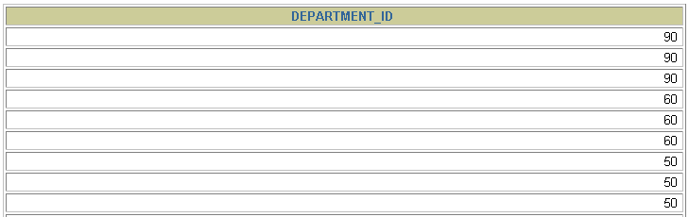
Duplicate Rows
The default display of queries is all rows, including duplicate rows.
SELECT department_id
FROM employees;
…
Notes:
Duplicate Rows
Unless you indicate otherwise, iSQL*Plus displays the results of a query without eliminating duplicate rows. The example on the slide displays all the department numbers from the EMPLOYEES table. Notice that the department numbers are repeated.

Slide 20
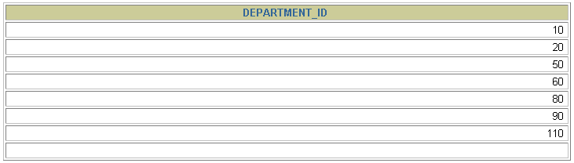
Eliminating Duplicate Rows
Eliminate duplicate rows by using the DISTINCT keyword in the SELECT clause.
SELECT DISTINCT department_id
FROM employees;
Notes:
Duplicate Rows (continued)
To eliminate duplicate rows in the result, include the DISTINCT keyword in the SELECT clause immediately after the SELECT keyword. In the example on the slide, the EMPLOYEES table actually contains 20 rows but there are only seven unique department numbers in the table.
You can specify multiple columns after the DISTINCT qualifier. The DISTINCT qualifier affects all the selected columns, and the result is every distinct combination of the columns.
SELECT DISTINCT department_id, job_id
FROM employees;
…

Slide 21
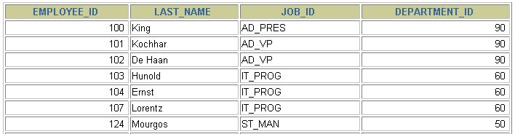

Limiting Rows Using a Selection
EMPLOYEES
…
“retrieve all employees in department 90”
Notes:
Limiting Rows Using a Selection
In the example on the slide, assume that you want to display all the employees in department 90. The rows with a value of 90 in the DEPARTMENT_ID column are the only ones returned. This method of restriction is the basis of the WHERE clause in SQL.

Slide 22
Limiting the Rows Selected
Restrict the rows returned by using the WHERE clause.
The WHERE clause follows the FROM clause.
SELECT *|{[DISTINCT] column|expression [alias],...}
FROM table
[WHERE condition(s)];
Notes:
Limiting the Rows Selected
You can restrict the rows returned from the query by using the WHERE clause. A WHERE clause contains a condition that must be met, and it directly follows the FROM clause. If the condition is true, the row meeting the condition is returned.
In the syntax:
WHERE restricts the query to rows that meet a condition
condition is composed of column names, expressions, constants, and a comparison operator
The WHERE clause can compare values in columns, literal values, arithmetic expressions, or functions. It consists of three elements:
Column name
Comparison condition
Column name, constant, or list of values

Slide 23

Using the WHERE Clause
SELECT employee_id, last_name, job_id, department_id
FROM employees
WHERE department_id = 90 ;
Notes:
Using the WHERE Clause
In the example, the SELECT statement retrieves the name, job ID, and department number of all employees whose job ID is SA_REP.
Note that the job title SA_REP has been specified in uppercase to ensure that it matches the job ID column in the EMPLOYEES table. Character strings are case sensitive.

Slide 24
Comparison Conditions
Operator
=
>
>=
<
<=
<>
Meaning
Equal to
Greater than
Greater than or equal to
Less than
Less than or equal to
Not equal to
Notes:
Comparison Conditions
Comparison conditions are used in conditions that compare one expression to another value or expression. They are used in the WHERE clause in the following format:
Syntax
... WHERE expr operator value
For Example
... WHERE hire_date='01-JAN-95'
... WHERE salary>=6000
... WHERE last_name='Smith'
An alias cannot be used in the WHERE clause.
Note: The symbol != and ^= can also represent the not equal to condition.

Slide 25

Using Comparison Conditions
SELECT last_name, salary
FROM employees
WHERE salary <= 3000;
Notes:
Using the Comparison Conditions
In the example, the SELECT statement retrieves the last name and salary from the EMPLOYEES table, where the employee salary is less than or equal to 3000. Note that there is an explicit value supplied to the WHERE clause. The explicit value of 3000 is compared to the salary value in the SALARY column of the EMPLOYEES table.

Slide 26
Other Comparison Conditions
Operator
BETWEEN ...AND...
IN(set)
LIKE
IS NULL
Meaning
Between two values (inclusive),
Match any of a list of values
Match a character pattern
Is a null value

Slide 27
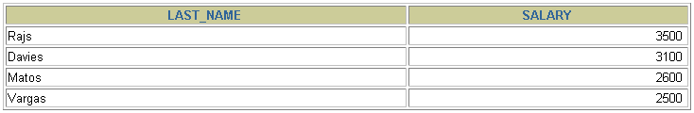
Using the BETWEEN Condition
Use the BETWEEN condition to display rows based on a range of values.
SELECT last_name, salary
FROM employees
WHERE salary BETWEEN 2500 AND 3500;
Lower limit
Upper limit
Notes:
The BETWEEN Condition
You can display rows based on a range of values using the BETWEEN range condition. The range that you specify contains a lower limit and an upper limit.
The SELECT statement on the slide returns rows from the EMPLOYEES table for any employee whose salary is between $2,500 and $3,500.
Values specified with the BETWEEN condition are inclusive. You must specify the lower limit first.
Instructor Note
Emphasize that the values specified with the BETWEEN operator in the example are inclusive. Explain that BETWEEN … AND … is actually translated by Oracle server to a pair of AND conditions: (a >= lower limit) AND (a <= higher limit). So using BETWEEN … AND … has no performance benefits, and it is used for logical simplicity.
Demo: 2_betw.sql
Purpose: To illustrate using the BETWEEN operator.

Slide 28
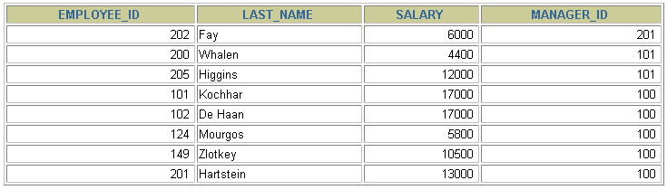
Using the IN Condition
Use the IN membership condition to test for values in
a list.
SELECT employee_id, last_name, salary, manager_id
FROM employees
WHERE manager_id IN (100, 101, 201);
Notes:
The IN Condition
To test for values in a specified set of values, use the IN condition. The IN condition is also known as the membership condition.
The slide example displays employee numbers, last names, salaries, and manager’s employee numbers for all the employees whose manager’s employee number is 100, 101, or 201.
The IN condition can be used with any data type. The following example returns a row from the EMPLOYEES table for any employee whose last name is included in the list of names in the WHERE clause:
SELECT employee_id, manager_id, department_id
FROM employees
WHERE last_name IN ('Hartstein', 'Vargas');
If characters or dates are used in the list, they must be enclosed in single quotation marks ('').
Instructor Note
Explain that IN ( ... ) is actually translated by Oracle server to a set of OR conditions: a = value1 OR a = value2 OR a = value3. So using IN ( ... ) has no performance benefits, and it is used for logical simplicity.
Demo: 2_in.sql
Purpose: To illustrate using the IN operator.

Slide 29
Using the LIKE Condition
Use the LIKE condition to perform wildcard searches of valid search string values.
Search conditions can contain either literal characters or numbers:
% denotes zero or many characters.
_ denotes one character.
SELECT first_name
FROM employees
WHERE first_name LIKE 'S%';
Notes:
The LIKE Condition
You may not always know the exact value to search for. You can select rows that match a character pattern by using the LIKE condition. The character pattern-matching operation is referred to as a wildcard search. Two symbols can be used to construct the search string.
The SELECT statement on the slide returns the employee first name from the EMPLOYEES table for any employee whose first name begins with an S. Note the uppercase S. Names beginning with an s are not returned.
The LIKE condition can be used as a shortcut for some BETWEEN comparisons. The following example displays the last names and hire dates of all employees who joined between January 1995 and December 1995:
SELECT last_name, hire_date
FROM employees
WHERE hire_date LIKE '%95';

Slide 30

Using the LIKE Condition
You can combine pattern-matching characters.
You can use the ESCAPE identifier to search for the actual % and _ symbols.
SELECT last_name
FROM employees
WHERE last_name LIKE '_o%';
Notes:
Combining Wildcard Characters
The % and _ symbols can be used in any combination with literal characters. The example on the slide displays the names of all employees whose last names have an o as the second character.
The ESCAPE Option
When you need to have an exact match for the actual % and _ characters, use the ESCAPE option. This option specifies what the escape character is. If you want to search for strings that contain ‘SA_’, you can use the following SQL statement:
SELECT employee_id, last_name, job_id
FROM employees
WHERE job_id LIKE '%SA\_%' ESCAPE '\';
The ESCAPE option identifies the backslash (\) as the escape character. In the pattern, the escape character precedes the underscore (_). This causes the Oracle Server to interpret the underscore literally.

Slide 31
Using the NULL Conditions
Test for nulls with the IS NULL operator.
SELECT last_name, manager_id
FROM employees
WHERE manager_id IS NULL;
Notes:
The NULL Conditions
The NULL conditions include the IS NULL condition and the IS NOT NULL condition.
The IS NULL condition tests for nulls. A null value means the value is unavailable, unassigned, unknown, or inapplicable. Therefore, you cannot test with = because a null cannot be equal or unequal to any value. The slide example retrieves the last names and managers of all employees who do not have a manager.
For another example, to display last name, job ID, and commission for all employees who are NOT entitled to get a commission, use the following SQL statement:
SELECT last_name, job_id, commission_pct
FROM employees
WHERE commission_pct IS NULL;
…

Slide 32
Logical Conditions
Operator
AND OR
NOT
Meaning
Returns TRUE if both component conditions are true
Returns TRUE if either component condition is true
Returns TRUE if the following condition is false
Notes:
Logical Conditions
A logical condition combines the result of two component conditions to produce a single result based on them or inverts the result of a single condition. A row is returned only if the overall result of the condition is true. Three logical operators are available in SQL:
AND
OR
NOT
All the examples so far have specified only one condition in the WHERE clause. You can use several conditions in one WHERE clause using the AND and OR operators.

Slide 33

Using the AND Operator
AND requires both conditions to be true.
SELECT employee_id, last_name, job_id, salary
FROM employees
WHERE salary >=10000
AND job_id LIKE '%MAN%';
Notes:
The AND Operator
In the example, both conditions must be true for any record to be selected. Therefore, only employees who have a job title that contains the string MAN and earn $10,000 or more are selected.
All character searches are case sensitive. No rows are returned if MAN is not in uppercase. Character strings must be enclosed in quotation marks.
AND Truth Table
The following table shows the results of combining two expressions with AND:
Instructor Note
Demo: 2_and.sql
Purpose: To illustrate using the AND operator.

Slide 34
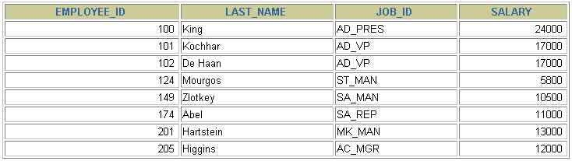
Using the OR Operator
SELECT employee_id, last_name, job_id, salary
FROM employees
WHERE salary >= 10000
OR job_id LIKE '%MAN%';
Notes:
The OR Operator
In the example, either condition can be true for any record to be selected. Therefore, any employee who has a job ID containing MAN or earns $10,000 or more is selected.
The OR Truth Table
The following table shows the results of combining two expressions with OR:

Slide 35
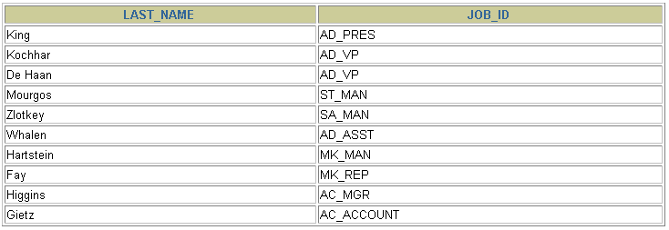
Using the NOT Operator
SELECT last_name, job_id
FROM employees
WHERE job_id
NOT IN ('IT_PROG', 'ST_CLERK', 'SA_REP');
Notes:
The NOT Operator
The slide example displays the last name and job ID of all employees whose job ID is not IT_PROG, ST_CLERK, or SA_REP.
The NOT Truth Table
The following table shows the result of applying the NOT operator to a condition:
Note: The NOT operator can also be used with other SQL operators, such as BETWEEN, LIKE, and NULL.
... WHERE job_id NOT IN ('AC_ACCOUNT', 'AD_VP')
... WHERE salary NOT BETWEEN 10000 AND 15000
... WHERE last_name NOT LIKE '%A%'
... WHERE commission_pct IS NOT NULL

Slide 36
Rules of Precedence
Order Evaluated Operator
1 Arithmetic operators
2 Concatenation operator
3 Comparison conditions
4 IS [NOT] NULL, LIKE, [NOT] IN
5 [NOT] BETWEEN
6 NOT logical condition
7 AND logical condition
8 OR logical condition
Override rules of precedence by using parentheses.
Notes:
Rules of Precedence
The rules of precedence determine the order in which expressions are evaluated and calculated. The table lists the default order of precedence. You can override the default order by using parentheses around the expressions you want to calculate first.

Slide 37
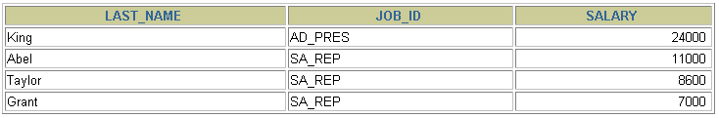
Rules of Precedence
SELECT last_name, job_id, salary
FROM employees
WHERE job_id = 'SA_REP'
OR job_id = 'AD_PRES'
AND salary > 15000;
Notes:
Example of the Precedence of the AND Operator
In the slide example, there are two conditions:
The first condition is that the job ID is AD_PRES and the salary is greater than 15,000.
The second condition is that the job ID is SA_REP.
Therefore, the SELECT statement reads as follows:
“Select the row if an employee is a president and earns more than $15,000, or if the employee is a sales representative.”
Instructor Note
Demo: 2_sal1.sql
Purpose: To illustrate the rules of precedence.

Slide 38
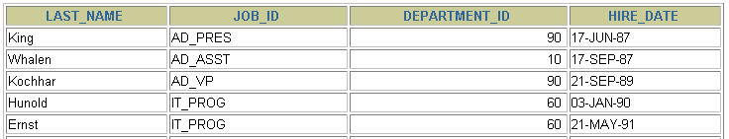
ORDER BY Clause
Sort rows with the ORDER BY clause
ASC: ascending order, default
DESC: descending order
The ORDER BY clause comes last in the SELECT statement.
SELECT last_name, job_id, department_id, hire_date
FROM employees
ORDER BY hire_date ;
…
Notes:
The ORDER BY Clause
The order of rows returned in a query result is undefined. The ORDER BY clause can be used to sort the rows. If you use the ORDER BY clause, it must be the last clause of the SQL statement. You can specify an expression, or an alias, or column position as the sort condition.
Syntax
SELECT expr
FROM table
[WHERE condition(s)]
[ORDER BY {column, expr} [ASC|DESC]];
In the syntax:
ORDER BY specifies the order in which the retrieved rows are displayed
ASC orders the rows in ascending order (this is the default order)
DESC orders the rows in descending order
If the ORDER BY clause is not used, the sort order is undefined, and the Oracle server may not fetch rows in the same order for the same query twice. Use the ORDER BY clause to display the rows in a specific order.
Instructor Note
Let the students know that the ORDER BY clause is executed last in query execution. It is placed last unless the FOR UPDATE clause is used.

Slide 39
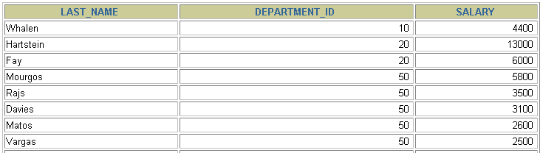
Sorting by Multiple Columns
The order of ORDER BY list is the order of sort.
You can sort by a column that is not in the SELECT list.
SELECT last_name, department_id, salary
FROM employees
ORDER BY department_id, salary DESC;
…
Notes:
Sorting by Multiple Columns
You can sort query results by more than one column. The sort limit is the number of columns in the given table.
In the ORDER BY clause, specify the columns, and separate the column names using commas. If you want to reverse the order of a column, specify DESC after its name. You can also order by columns that are not included in the SELECT clause.
Example
Display the last names and salaries of all employees. Order the result by department number, and then in descending order by salary.
SELECT last_name, salary
FROM employees
ORDER BY department_id, salary DESC;
Instructor Note
Show that the DEPARTMENT_ID column is sorted in ascending order and the SALARY column in descending order.

Slide 40

Aggregate Functions
• AVG
• COUNT
• MAX
• MIN
• SUM

Slide 41

Tipe-tipe Group Function
Fungsi | Hasil
AVG([DISTINCT|ALL]n) | Nilai rata-rata dari n, nilai null diabaikan
COUNT({*|[DISTINCT|ALL] expr}) | Jumlah baris, nilai null tidak diabaikan bila menggunakan * atau ALL
MAX([DISTINCT|ALL]expr) | Nilai maximum dari expr, nilai null diabaikan
MIN([DISTINCT|ALL]expr) | Nilai minimum dari expr, nilai null diabaikan
SUM([DISTINCT|ALL]n) | Jumlah nilai dari n, nilai null diabaikan
Notes:
Penggunaan format Group Functions:
• DISTINCT artinya data yang akan digunakan hanya data yang tidak duplikat.
ALL atinya semua data digunakan termasuk data yang duplikat dan ini merupakan DEFAULT sehingga
keyword ALL tidak harus dituliskan.
• Tipe data untuk fungsi dengan argumen expr bisa CHAR, VARCHAR2, NUMBER, atau DATE.
• Semua group functions mengabaikan nilai null. Untuk mengganti nilai null, dapat digunakan fungsi2
NVL, NVL2, atau COALESCE .

Slide 42
Sintaks Group Function
SELECT [column,] group_function(column), ...
FROM table
[WHERE condition]
[GROUP BY column]
[ORDER BY column];
Notes:
Urutan sintaks SQL dengan group function adalah
1. Klausa SELECT dengan kolom-kolomnya dan group functionnya
2. Klausa FROM untuk menyebutkan tabel yang digunakan
3. Klausa WHERE untuk pernyataan kondisi
4. Klausa GROUP BY, harus ada dan kolom yang ada dalam klausa ini harus sama dengan kolom yang tidak terdapat dalam group function.
5. Klausa ORDER BY untuk mengurutkan tampilan data.

Slide 43
Penggunaan Fungsi AVG dan SUM
Fungsi AVG, SUM, MIN, dan MAX dapat digunakan pada kolom yang menyimpan data numerik.
SELECT AVG(salary), MAX(salary), MIN(salary), SUM(salary)
FROM employees
WHERE job_id LIKE '%REP%';
AVG(SALARY) MAX(SALARY) MIN(SALARY) SUM(SALARY)
8272,72727 11500 6000 273000

Slide 44
Penggunaan Fungsi MIN dan MAX
Fungsi MIN, dan MAX dapat digunakan pada kolom yang menyimpan data numerik, karakter, dan date.
SELECT MIN(hire_date), MAX(hire_date)
FROM employees;
MIN(HIRE_DATE MAX(HIRE_DATE)
17-06-1987 21-04-2000

Slide 45
Penggunaan Fungsi COUNT
COUNT(*) menghasilkan jumlah baris data dalam tabel:
SELECT COUNT(*)
FROM employees
WHERE department_id = 50;
COUNT(*)
45
COUNT(expr) menghasilkan jumlah baris dari expr yang tidak bernilai null:
SELECT COUNT(commission_pct)
FROM employees
WHERE department_id = 80;
COUNT(COMMISSION_PCT)
34
Notes:
Fungsi COUNT akan menghasilkan jumlah baris data dalam tabel.
Ada 3 format fungsi COUNT , yaitu:
• COUNT(*)
• COUNT(expr)
• COUNT(DISTINCT expr)
COUNT(*) menampilkan jumlah baris data dalam tabel sesuai dengan kondisi dalam klausa WHERE apabila ada,
Termasuk data yang duplikat dan data yang bernilai null.
Sebaliknya, COUNT(expr) menampilkan jumlah baris data yang tidak bernilai null yang ada dalam kolom yang
Diidentifikasi oleh expr
COUNT(DISTINCT expr) menampilkan jumlah data, tanpa melihat data duplikat dan data bernilai null dari kolom yang
Diidentifikasi oleh expr.
Contoh pertama pada slide menampilkan jumlah employee di dept id 50.
Contoh yang ke dua menmpilkan jumlah employee di dept id 80 yang nilai comm pct ny tidak null.

Slide 46
Penggunaan keyword DISTINCT
• COUNT(DISTINCT expr) menghasilkan jumlah baris expr dengan tidak menghitung baris duplikat dan yang bernilai null.
SELECT COUNT(DISTINCT department_id)
FROM employees;
COUNT(DISTINCTDEPARTMENT_ID)
11
Notes:
Penggunaan keyword DISTINCT pada fungsi COUNT bertujuan agar baris yang duplikat (>1) untuk kolom
Yang disebutkan dalam ekspresi dihitung hanya 1 baris, dan yang bernilai NULL tidak dihitung.
Contoh pada slide sintaks SQL menghitung jumlah baris untuk kolom department_id dengan mengeliminasi
Baris yang duplikat dan yang bernilai NULL.

Slide 47
Penggunaan GroupFunction dan Nilai Null
Group function mengabaikan nilai null
SELECT AVG(commission_pct)
FROM employees;
AVG(COMMISSION_PCT)
,222857143
Fungsi NVL merubah nilai null menjadi 0 sehingga group functions harus menghitung baris yang bernilai null
SELECT AVG(NVL(commission_pct, 0))
FROM employees;
AVG(NVL(COMMISSION_PCT,0))
,072897196
Notes:
Penggunaan Group Functions akan mengabaikan nilai Null. Bila nilai null
Akan diperhitungkan, maka harus digunakan fungsi NVL yang akan mengkonversi
Nilai NULL menjadi 0.
Contoh pada slide:
Sintaks yang pertama menghitung rata-rata comm_pct berdasarkan baris dalam tabel
Yang mempunyai nilai comm_pct . Perhitungannya adalah Jumlah total comm_pct
dibagi total employees yang menerima comm.
Sintaks yang ke dua menghitung rata-rata comm pct berdasarkan semua baris dalam tabel
Termasuk yang bernilai null. Perhitungannya adalah total comm pct dibagi total employee.
Dapat dilihat bahwa kedua sintaks memberikan hasil yang berbeda.

Slide 48
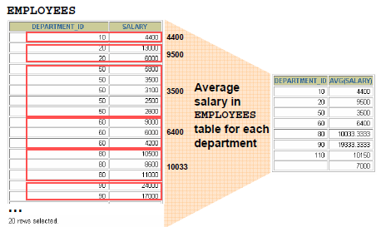
Membuat Group Data
Data dalam tabel dapat dibagi-bagi menjadi beberapa kelompok
Notes:
Membuat Groups Data
Pada slide sebelumnya telah dijelaskan bahwa semua group function menganggap tabel sebagai satu grup informasi.
Terkadang kita harus membagi informasi dalam tabel menjadi beberapa grup kecil. Hal ini dapat dilakukan dengan
Menggunakan klausa GROUP BY.
Contoh ilustrasi pada slide memperlihatkan data rata-rata salary tetapi dibagi lagi menjadi grup departemen. Sehingga
Hasil yang diperoleh adalah rata-rata salary untuk setiap departemen.

Slide 49
Sintaks Klausa GROUP BY
Dengan menggunakan klausa GROUP BY, maka data-data dalam tabel dapat dibagi-bagi menjadi kelompok yang lebih kecil. Formatnya:
SELECT column, group_function(column)
FROM table
[WHERE condition]
[GROUP BY group_by_expression]
[ORDER BY column];
Notes:
Kita dapat menggunakan klausa GROUP BY, agar data-data dalam tabel dapat dibagi menjadi kelompok yang lebih kecil
Dengan menggunakan group function akan dihasilkan rangkuman informasi setiap grup.
Dalam format sintaks:
Ekspresi GROUP BYmenyebutkan nama kolom dimana nilainya menentukan dasar dari pengelompokkan baris data.
• jika kita menggunakan group function dalam klausa SELECT, kita tidak dapat menampilkan hasilnya untuk setiap
Baris data, tetapi akan ditampilkan per grup sesuai pada klausa GROUP BY.
• Penggunaan klausa WHERE menjadikan data-data dipilih dulu sebelum dikelompokkan.
• Kolom yang terdapat dalam klausa GROUP BY, harus ada dalam klausa SELECT.
• alias Kolom tidak bisa digunakan dalam klausa GROUP BY.

Slide 50
Penggunaan Klausa GROUP BY
Semua kolom dalam SELECT yang tidak dimasukkan ke group Function harus ada dalam klausa GROUP BY.
SELECT department_id, AVG(salary)
FROM employees
GROUP BY department_id ;
DEPARTMENT_ID AVG(SALARY)
100 8600
30 4150
7000
90 19333,3333
20 9500
70 10000
110 10150
...
Notes:
Jika menggunakan klausa GROUP BY, pastikan semua kolom yang ada dalam klausa SELECT,
Yang bukan dalam group function, harus ada dalam klausa GROUP BY.
Contoh pada slide menampilkan dept id, rata-rata salary untuk setiap dept id.
Bagaimana sintaks ini diproses dalam server basis data?
1. Klausa SELECT menyebutkan kolom-kolom yang harus diambil, yaitu :
- Kolom Department id dalam tabel EMPLOYEES
- rata-rata salary dalam grup berdasarkan kolom yang ditulis dalam klausa GROUP BY
2. Klausa FROM menyebutkan nama tabel yang harus diakses yaitu tabel EMPLOYEES
3. Klausa WHERE memilih baris data. Karena tidak ada klausa WHERE, maka semua data dipilih.
4. Klausa GROUP BY menentukan bagaimana baris-baris data harus dikelompokkan. Baris data dikelompokkan
Berdasarkan department id, sehingga fungsi AVG yang diaplikasikan terhadap kolom salary menghitung rata-
Rata salary untuk setiap dept id.

Slide 51
Penggunaan Klausa GROUP BY
Kolom dalam GROUP BY tidak harus ada dalam SELECT.
SELECT AVG(salary)
FROM employees
GROUP BY department_id ;
AVG(SALARY)
8600
4150
7000
19333,3333
9500
10000
10150
...
Notes:
Nama kolom dalam klausa GROUP BY tidak harus ada dalam klausa SELECT.
Contoh pada slide sintaks SELECT menampilkan rata-rata salary untuk setiap departemen
Tanpa menampilkan kolom dept id.
Tetapi tanpa kolom dept id, data yang ditampilkan menjadi kurang informatif
sehingga akan lebih baik apabila kolom dept id disertakan dalam klausa SELECT

Slide 52
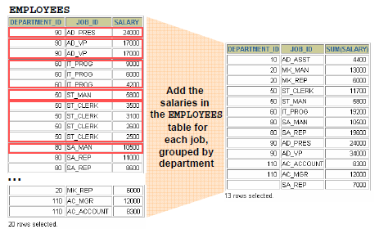
GROUP BY Lebih dari Satu Kolom
Total Salary yang dibayarkan untuk setiap job dalam setiap departemen.
Notes:
Terkadang kita membutuhkan data yang ditampilkan per grup dalam grup.
Sebagai ilustrasi, pada slide memperlihatkan laporan yang menampilkan total salary untuk
Setiap job title pada setiap departemen.
Tabel EMPLOYEES, pertama digrupkan berdasarkan dept id, kemudian hasilnya digrupkan lagi
Berdasarkan job title.
Contoh semua IT programmer di dept id 60 digrupkan, kemudian salary untuk semua IT prog
Dijumlahkan menghasilkan total salary utk IT Prog di dept id 60.

Slide 53
Penggunaan Klausa GROUP BY pada Beberapa Kolom
SELECT department_id dept_id, job_id, SUM(salary)
FROM employees
GROUP BY department_id, job_id ;
DEPT_ID JOB_ID SUM(SALARY)
110 AC_ACCOUNT 8300
90 AD_VP 34000
50 ST_CLERK 55700
80 SA_REP 243500
50 ST_MAN 36400
80 SA_MAN 61000
100 FI_ACCOUNT 39600
SA_REP 7000
70 PR_REP 10000
Notes:
Groups Within Groups (continued)
Kita dapat menghasilkan rangkuman data untuk grup dan subgrup dengan membagi menjadi
lebih dari satu kolom dalam GROUP BY.
Kita juga dapat mengurutkan data dengan menggunakan klausa ORDER BY.
Contoh pada slide akan mengikuti proses sbb:
1. Klausa SELECT menyebutkan nama kolom untuk diambil, yaitu:
- Department id dalam tabel EMPLOYEES
- Job ID dalam tabel EMPLOYEES
- Jumlah salary dalam grup berdasarkan nama kolom yang ada dlam klausa GROUP BY
2. Klausa FROM menyebutkan nama tabel dalam basis data yang harus diakses yaitu tabel EMPLOYEES
3. Klausa GROUP BY menentukan bagaimana data harus digrupkan.
- pertama, data digrupkan berdasarkan department id.
- Ke dua, hasil yang pertama digrupkan lagi berdasarkan job ID.
Jadi fungsi SUM digunakan terhadap kolom salary untuk semua job ID dalam setiap departement id

Slide 54
Penggunaan GROUP Function yang Salah
Kolom-kolom yang ada dalam SELECT tetapi tidak termasuk dalam fungsi agregasi, harus ada dalam klausa GROUP BY
SELECT department_id, COUNT(last_name)
FROM employees;
SELECT department_id, COUNT(last_name)
*
ORA-00937: not a single-group group function
Kolom department_id harus ada dalam GROUP BY.
Notes:
Group function dikenal juga sebagai fungsi agregasi.
Bila kita menggunakan kolom dalam klausa SELECT yang bukan dalam fungsi agregasi
Maka harus ada klausa GROUP BY untuk menyertakan nama kolom tersebut. Jika tidak, maka akan terjadi error
Seperti yang diperlihatkan dalam slide.
Sintaks SQL tidak menyertakan klausa GROUP BY sehingga terjadi error
ORA-00937: not a single-group function.
Jadi harus ditambahkan GROUP BY dept id setelah klausa FROM.

Slide 55
Penggunaan WHERE untuk GROUP Function
Untuk membatasi grup function tidak boleh menggunakan klausa WHERE, tetapi gunakan klausa HAVING.
SELECT department_id, AVG(salary)
FROM employees
WHERE AVG(salary) > 8000
GROUP BY department_id;
WHERE AVG(salary) > 8000
*
ORA-00934: group function is not allowed here
WHERE AVG(salary) > 8000 diganti dengan HAVING AVG(salary) > 8000
Notes:
Jika kita ingin menggunakan kondisi untuk fungsi agregasi maka klausa WHERE
Tidak dapat digunakan tetapi harus diganti dengan klausa HAVING.
Klausa WHERE dapat digunakan hanya untuk kondisi yang bukan fungsi agregasi.
Contoh pada slide memperlihatkan terjadinya error bila klausa WHERE digunakan
Untuk kondisi pada group function.
Seharusnya WHERE diganti dengan HAVING.
-------------------------------------
SELECT department_id, AVG(salary)
FROM employees
HAVING AVG(salary) > 8000
GROUP BY department_id;

Slide 56
Penggunaan Klausa HAVING
SELECT department_id, MAX(salary)
FROM employees
GROUP BY department_id
HAVING MAX(salary)>10000 ;
DEPARTMENT_ID MAX(SALARY)
100 12000
30 11000
90 24000
20 13000
110 12000
80 14000
6 rows selected.
Notes:
Hasil query menampilkan dept id dan maksimum salary dari tiap dept id
Dimana maksimum salary nya lebih besar dari 10,000.
Kita dapat menggunakan klausa GROUP BY tanpa fungsi agregasi dalam klausa SELECT.
Klausa HAVING dapat digunakan bila ada klausa GROUP BY.
Sebaliknya, kita tidak bisa menghilangkan klausa GROUP BY bila ada fungsi
Agregasi dalam klausa SELECT.

Slide 57
Penggunaan Klausa HAVING
SELECT job_id, SUM(salary) PAYROLL
FROM employees
WHERE job_id NOT LIKE '%REP%'
GROUP BY job_id
HAVING SUM(salary) > 13000
ORDER BY SUM(salary);
JOB_ID PAYROLL
PU_CLERK 13900
AD_PRES 24000
IT_PROG 28800
AD_VP 34000
ST_MAN 36400
FI_ACCOUNT 39600
...
9 rows selected.
Notes:
Klausa WHERE digunakan untuk membatasi data job id , klausa HAVING digunakan untuk membatasi fungsi
Agregasi SUM(salary).
Penempatan klausa WHERE adalah setelah klausa FROM, diikuti klausa GROUP BY, kemudian klausa HAVING
Dan yang terakhir klausa ORDER BY.
Hasil menampilkan data job ID dan total salary untuk setiap job ID (tidak termasuk Sales Representatif)
yang mempunyai total salary lebih dari 13,000.

Slide 58
Group Functions Bersarang
Menampilkan nilai rata-rata salary yang maksimum:
SELECT MAX(AVG(salary))
FROM employees
GROUP BY department_id;
MAX(AVG(SALARY))
19333,3333
Notes:
Group Functions dapat dibuat bersarang sampai 2 level.
Contoh pada slide menampilkan rata-rata salary yang maksimum.
Hasil yang diperoleh hanya satu karena dari rata-rata salary per departemen,
yang ditampilkan hanya satu yaitu yang paling tinggi nilai rata-ratanya.

Slide 59
Fungsi NVL
Untuk Merubah nilai null menjadi nilai aktual:
• Tipe data yang dapat digunakan : date, character, dan number.
• Tipe data nilai aktual harus cocok data yang akan dirubah, contoh:
– NVL(commission_pct,0)
– NVL(hire_date,'01-JAN-97')
– NVL(job_id,'No Job Yet')

Slide 60
Penggunaan Fungsi NVL
SELECT last_name, salary, NVL(commission_pct, 0),
(salary*12) + (salary*12*NVL(commission_pct, 0)) AN_SAL
FROM employees;
LAST_NAME SALARY NVL(COMMISSION_PCT,0) AN_SAL
King 24000 0 288000
Kochhar 17000 0 204000
De Haan 17000 0 204000
Hunold 9000 0 108000
Ernst 6000 0 72000
Austin 4800 0 57600
Pataballa 4800 0 57600
Lorentz 4200 0 50400
Notes:
Penggunaan Fungsi NVL
-Untuk menghitung kompensasi tahunan bagi karyawan, kita harus mengalikan salary dengan 12
Dan ditambah dengan besaran komisinya yaitu 12 kali salary kalikan lagi dengan comm_pct.
-Kompensasi tahunan ini dihitung hanya untuk karyawan yang nilai comm_pct nya tidak null.
-Jika suatu bilangan dilakukan perhitungan dengan null, maka hasilnya akan null.
-Untuk menghindari hasil perhitungan null, maka perlu digunakan fungsi NVL ini untuk merubah
nilai comm_pct yang null menjadi 0, sehingga an_sal tidak akan bernilai null.
-Hasil query pada slide menunjukkan last name KING mempunyai salary per bulan 24000 tetapi tidak mempunyai comm pct, dalah hal ini nilai comm pct nya NULL, sehingga dengan fungsi NVL kolom commpct nya jadi bernilai nol.
-Annual salary nya menjadi 12 kali 24000, dimana hasilnya adalah 288000.

Slide 61
Penggunaan Fungsi NVL2
SELECT last_name, salary, commission_pct,
NVL2(commission_pct, 'SAL+COMM', 'SAL') income
FROM employees
WHERE department_id IN (50, 80);
LAST_NAME SALARY COMMISSION_PCT INCOME
Davies 3100 SAL
Matos 2600 SAL
Vargas 2500 SAL
Russell 14000 ,4 SAL+COMM
Partners 13500 ,3 SAL+COMM
Errazuriz 12000 ,3 SAL+COMM
Notes:
Pada fungsi NVL2 terdapat 3 ekspresi. jika ekspresi yang pertama tidak null, maka nilai ekspresi yang ke dua
Akan dikembalikan. jika ekspresi yang pertama null, maka nilai ekspresi yang ke 3 akan dikembalikan.
Contoh pada slide ekspresi ke 1 adalah kolom comm_pct dimana kolom ini akan diuji.
Ekspresi ke 2 adalah ‘SAL+COMM’, dan ekspresi yang ke 3 adalah ‘SAL’.
Jika nilai comm_pct tidak null, maka hasil adalah ‘SAL+COMM’, tetapi bila nilai comm_pct nya null
Maka hasil adalah ‘SAL’.
Berbeda dengan fungsi NVL, fungsi NVL2 dapat mengembalikan nilai dengan tipe data yang berbeda
Dengan ekspresi pertama. Jadi expr2 dan expr3 dapat berbeda dengan expr pertama. expr2 biasanya mempunyai
Tipe data yang sama dengan expr3, tetapi bila berbeda, server basis data akan mengkonversi tipe data expr3
Menjadi tipe data expr2.

Slide 62
Penggunaan Fungsi NULLIF
SELECT first_name, LENGTH(first_name) "expr1",
last_name, LENGTH(last_name) "expr2",
NULLIF(LENGTH(first_name), LENGTH(last_name)) result
FROM employees;
FIRST_NAME expr1 LAST_NAME expr2 RESULT
Ellen 5 Abel 4 5
Sundar 6 Ande 4 6
Mozhe 5 Atkinson 8 5
David 5 Austin 6 5
Hermann 7 Baer 4 7
Shelli 6 Baida 5 6
Notes:
Fungsi NULLIF bekerja untuk membandingkan 2 ekspresi. Jika kedua ekspresi sama, fungsi mengembalikan nilai null,
Jika kedua ekspresi berbeda, fungsi mengembalikan nilai ekspresi pertama.
Contoh pada slide
Ekspresi pertama adalah panjang nilai kolom first_name, ekspresi ke dua adalah panjang nilai kolom last_name.
Jika hasil keduanya sama, maka kolom result menghasilkan nilai null, tetapi jika keduanya berbeda, kolom
Result akan menghasilkan ekspresi yg pertama.

Slide 63
SELESAI

